Slide 1

EDA Project - AMCAT Data Analysis

Slide 2
Columns Summary Table for dataset
ID: Candidate ID
Salary: Salary of the candidate
DOJ: Date of joining the job
DOL: Date of leaving the job
Designation: Job designation/title
JobCity: City where the job is located
Gender: Gender of the candidate
DOB: Date of birth of the candidate
10percentage: Percentage score in 10th grade
12percentage: Percentage score in 12th grade
CollegeID: College ID of the candidate
CollegeTier: Tier of the college
Degree: Degree pursued by the candidate
Specialization: Specialization pursued by the candidate
CollegeGPA: Grade Point Average in college
CollegeCityID: ID of the college city
CollegeCityTier: Tier of the college city
CollegeState: State where the college is located
GraduationYear: Year of graduation
Domain: Domain knowledge score
ComputerProgramming: Score in computer programming
ElectronicsAndSemicon: Score in electronics and semiconductors
ComputerScience: Score in computer science
MechanicalEngg: Score in mechanical engineering
ElectricalEngg: Score in electrical engineering
TelecomEngg: Score in telecommunications engineering
CivilEngg: Score in civil engineering
Conscientiousness, Agreeableness, Extraversion, Neuroticism,
Openness_to_experience: Personality trait scores

Slide 3
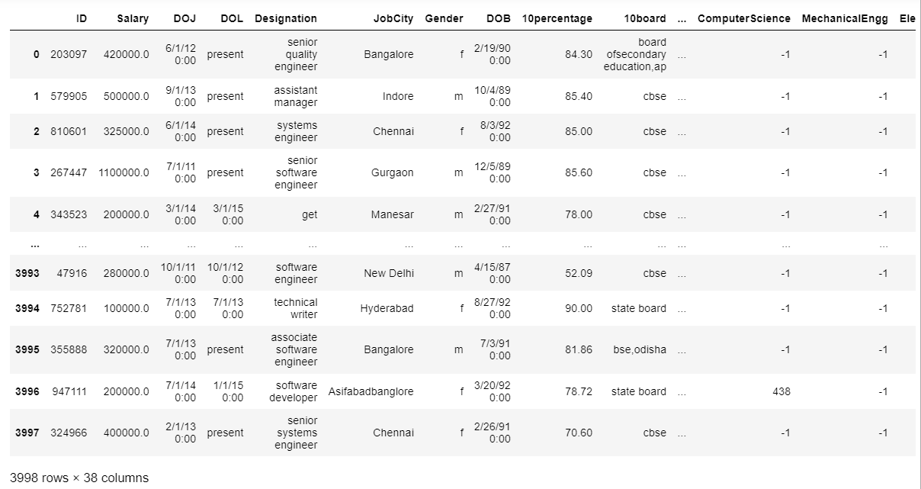
Raw Dataset
We Got 3998 rows and 38 Columns

Slide 4
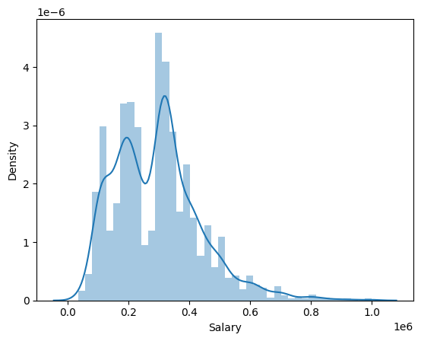
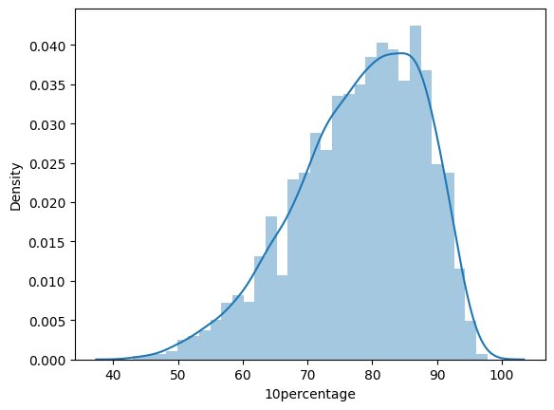
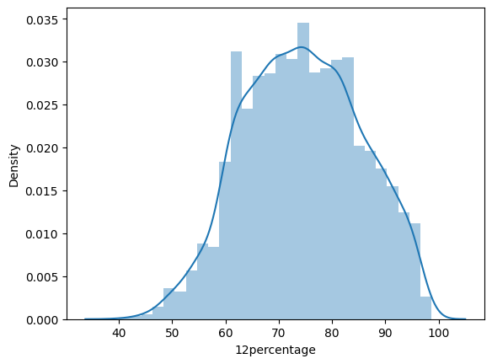
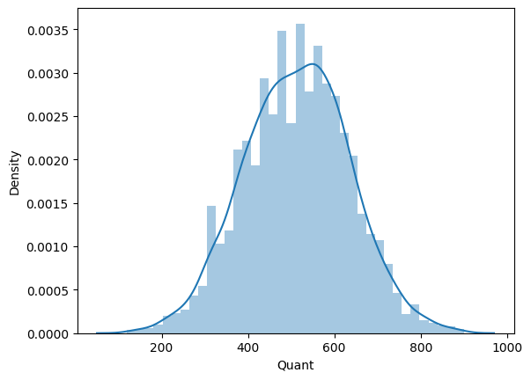
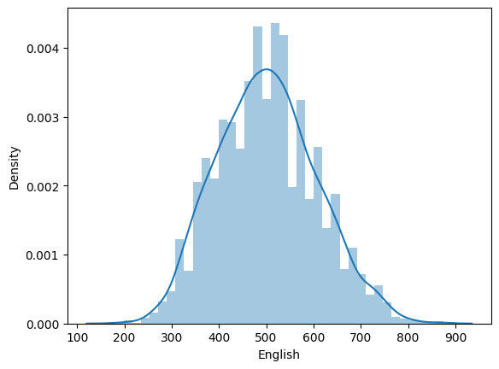
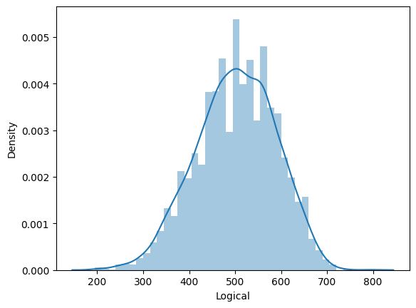
Univariate Analysis
Distplots

Slide 5
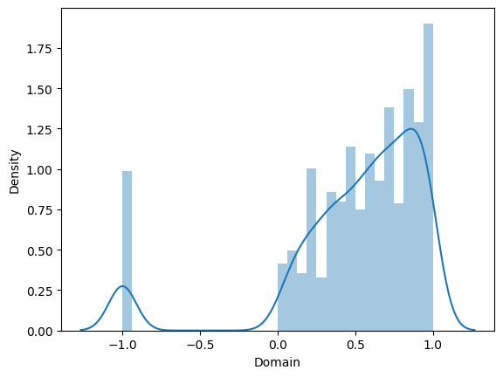
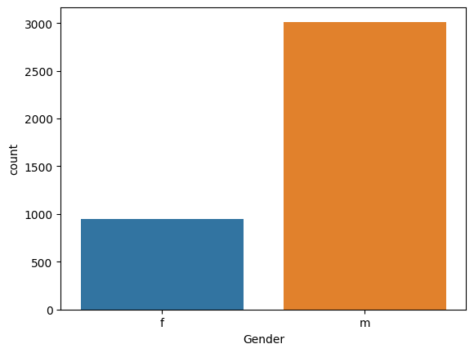
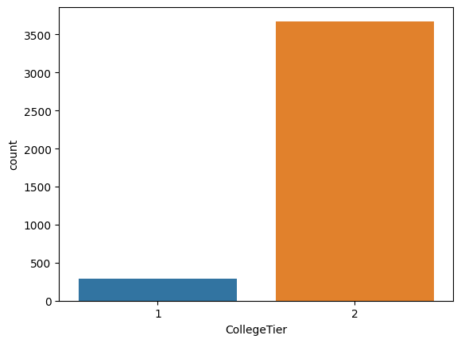
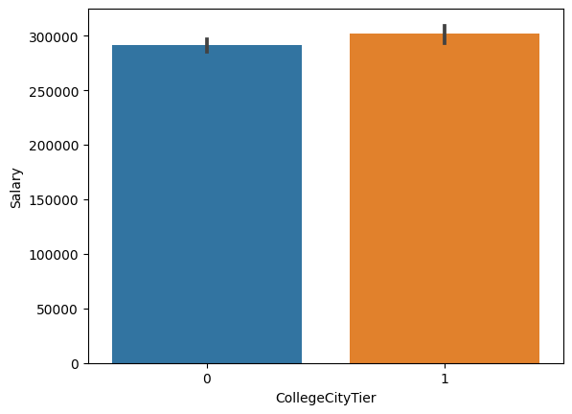
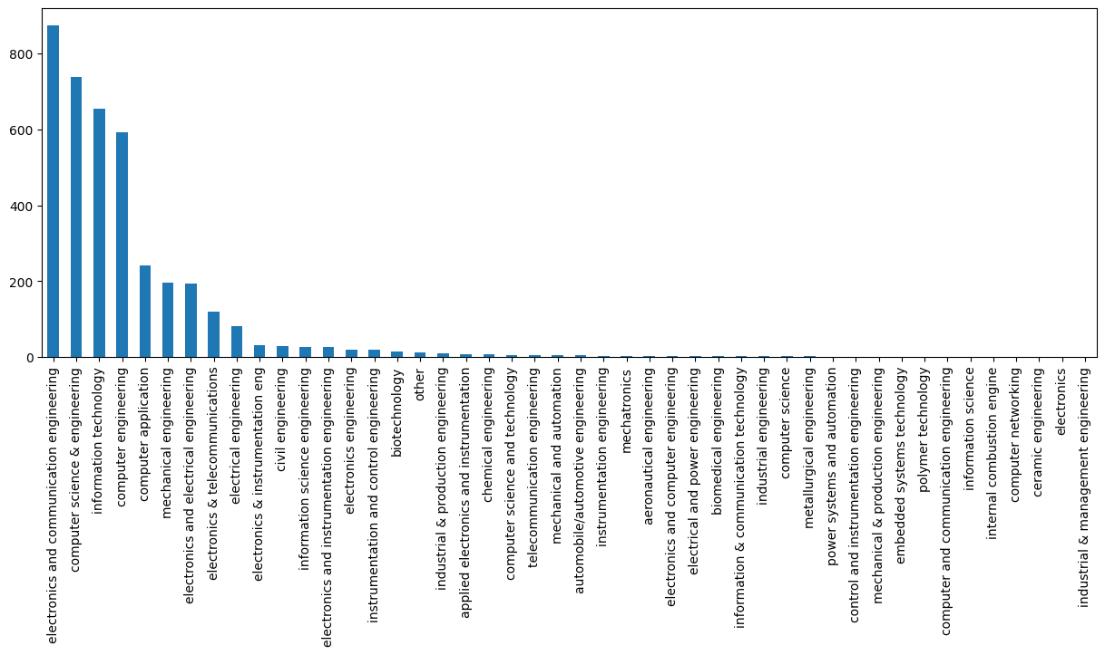
Countplot and Barplot and Distplot

Slide 6
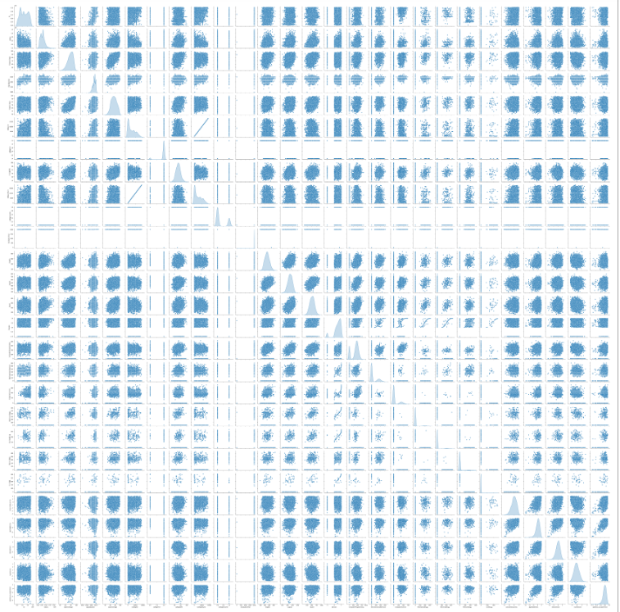
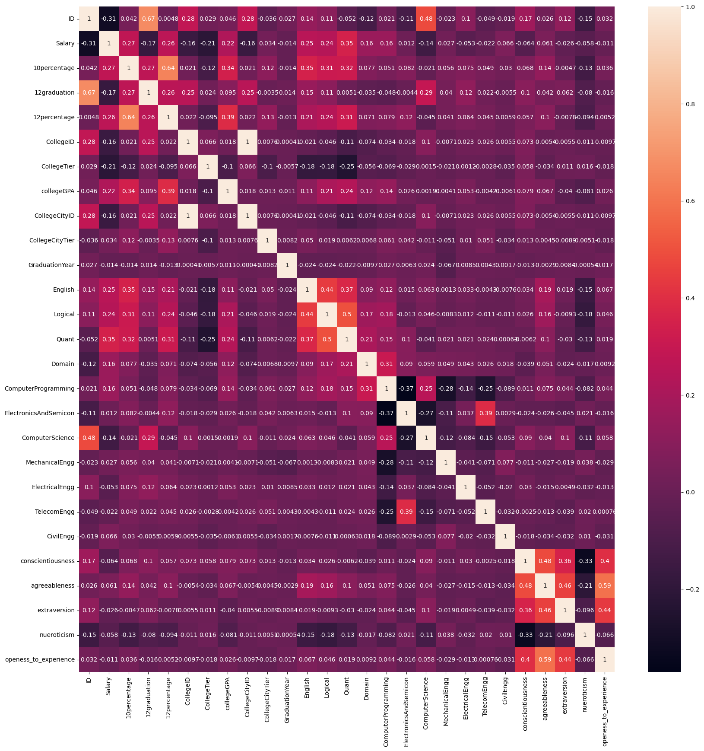
Bivariate Analysis
Heatmap and Pairplot

Slide 7
Conclusion:
The dataset comprises candidate details including ID, salary, job tenure, designation, location, gender, education, and personality traits.
Insights cover salary trends, demographics, education profiles, and personality influences on careers.
Understanding these facets informs recruitment, roles, and salary dynamics.

